Slide 1

IMAGE INSIGHT
“An AI-powered image caption generator that can analyze an image and produce a concise, accurate, and contextually relevant caption”
BY –
TEAM MEMBER 1- Khushi Saroha(E23CSEU1446)
TEAM MEMBER 2- Mehul Gupta(E23CSEU1423)
TEAM MEMBER 3- Tanmay Tyagi(E23CSEU1448)

Slide 2

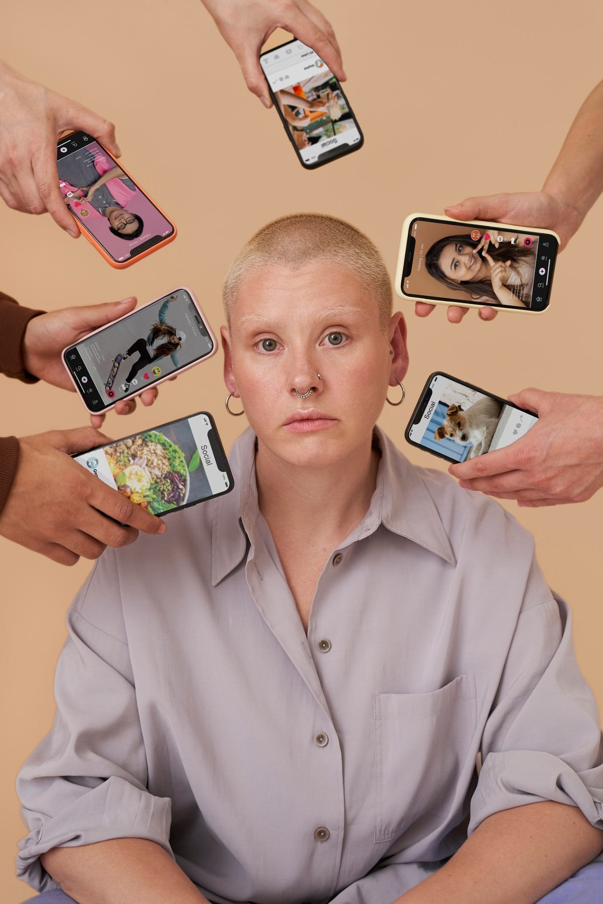
Introduction to Image Captioning
Image captioning combines computer vision and natural language processing to generate descriptive text for images. This ﬁeld has seen signiﬁcant advancements, driven by deep learning techniques and large datasets, enabling machines to understand and describe visual content more effectively.

Slide 3

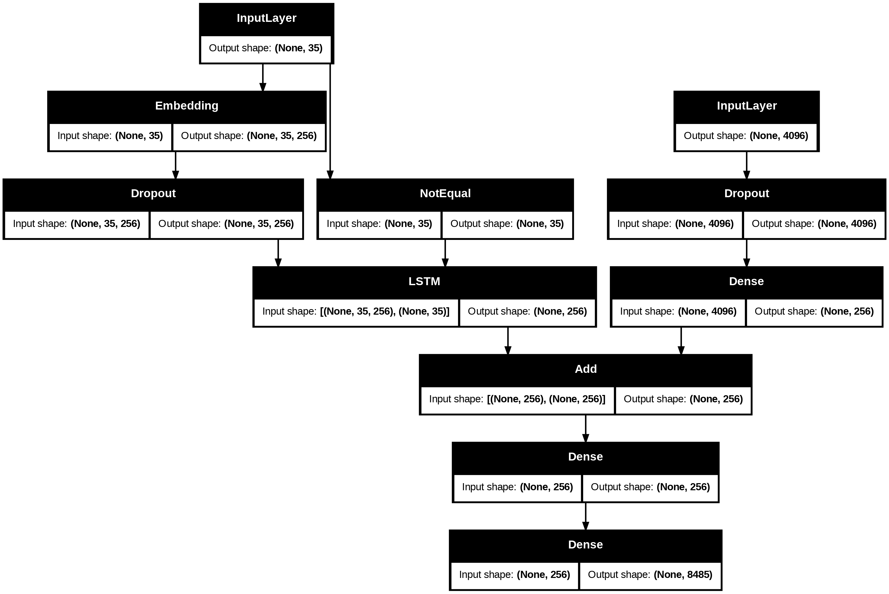
Key Techniques in Caption Generation
Recent advancements in image captioning involve Convolutional Neural Networks (CNNs) for image feature extraction and Recurrent Neural Networks (RNNs) for sequence generation. These techniques help in producing more accurate and contextually relevant captions, enhancing the overall quality of image description.

Slide 4


Datasets and Training Approaches
The effectiveness of image captioning models relies heavily on diverse and extensive datasets such as Flickr30k.
These datasets provide rich annotations that aid in training
models to generate captions that are not only accurate but also contextually appropriate.

Slide 5

Applications in Real World
Image captioning has numerous applications across industries, including social media, e- commerce, and accessibility tools for the visually impaired. These applications enhance user experience by providing contextual information, improving searchability, and enabling richer interactions with visual content.

Slide 6

Challenges in Image Captioning
Despite advancements, image captioning faces challenges such as ambiguity in images and the need for contextual understanding. Models often struggle with generating captions that accurately reﬂect complex scenes or emotions, necessitating ongoing research and development in this ﬁeld.

Slide 7

and
Conclusion Future Directions
In conclusion, advancements in image caption
generation have transformed how machines interpret
and describe images. Future directions involve improving contextual understanding and leveraging multimodal data to create even more sophisticated and accurate captioning systems, enhancing their applicability.

Slide 8

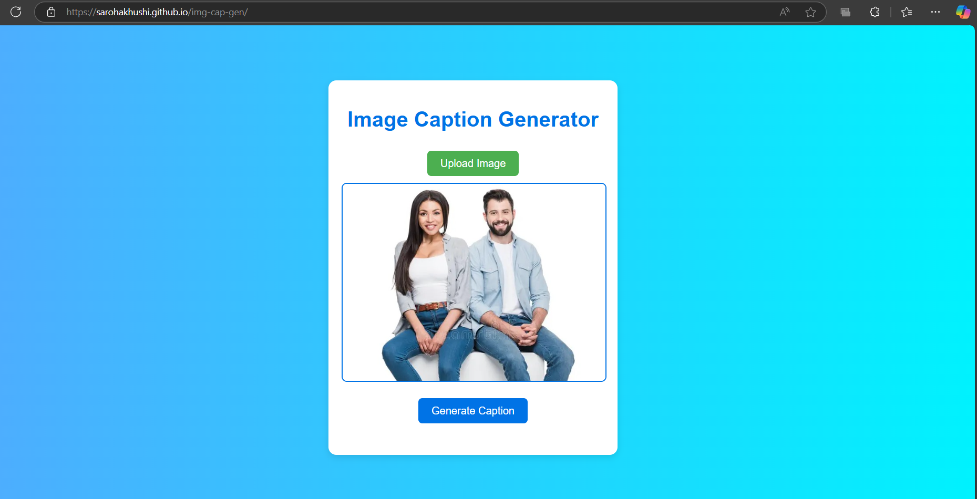
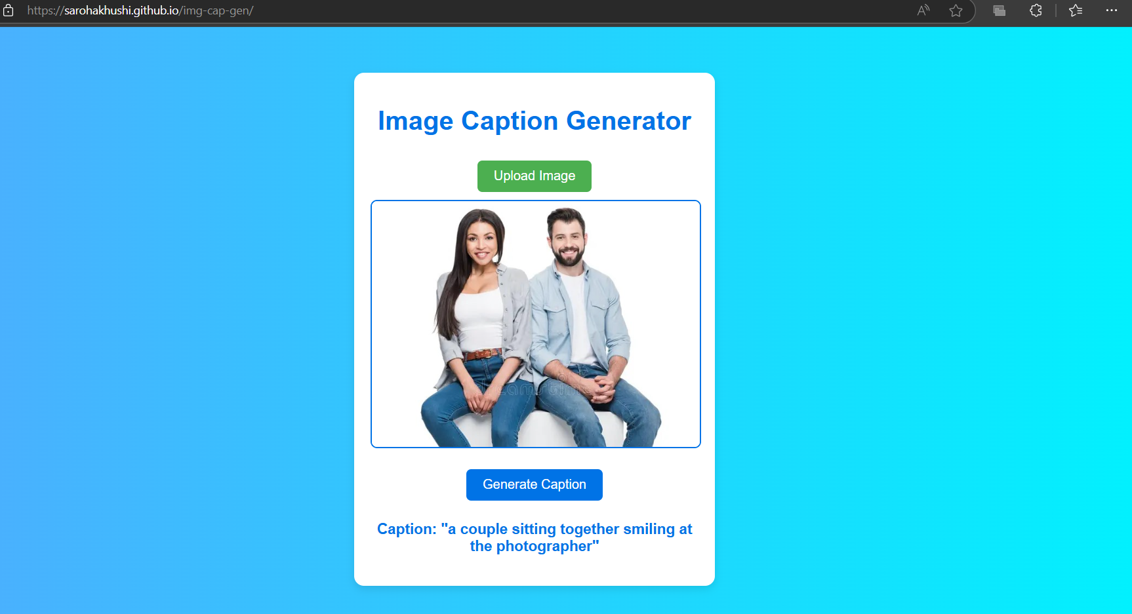
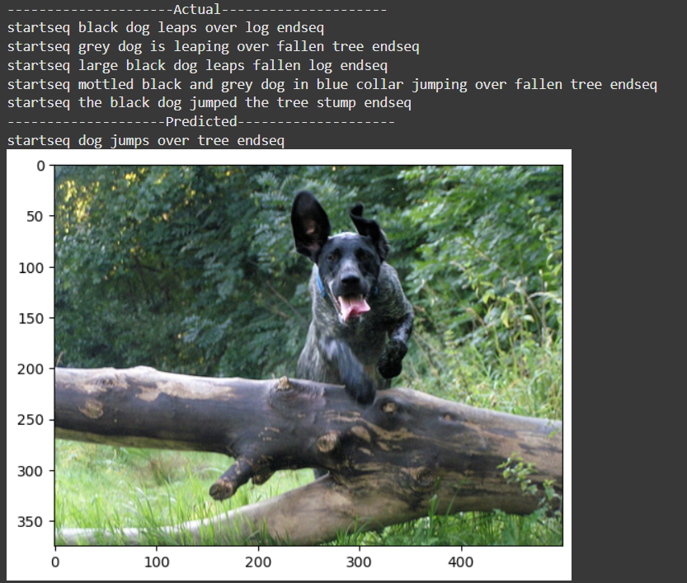
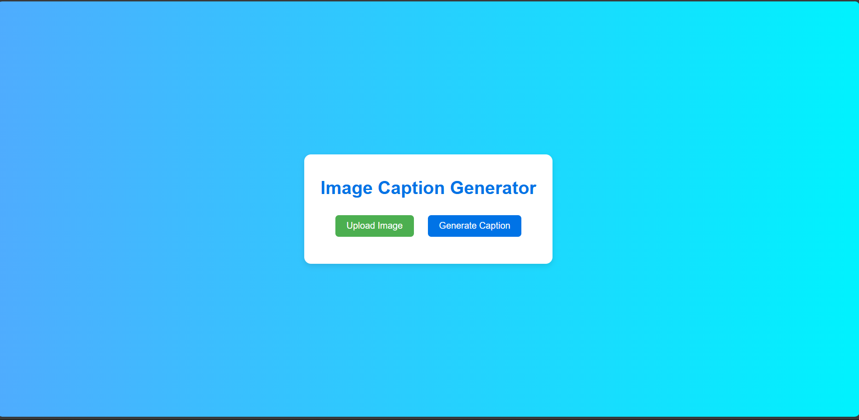
OUTPUT

Slide 9
Thanks!

